Slide 1
How to FP
By Jeremy Lim

Slide 2
Topics
Functional Interfaces and Lambdas
Java Functional Interfaces
Understanding Functional Programming

Slide 3

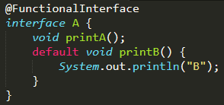
Functional Interface
Interfaces with ONE abstract method
Can have other methods but must be default
(the hole)

Slide 4
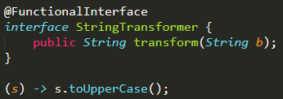
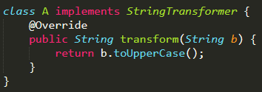
Lambdas
Convert a function to a class using Functional Interfaces
Format:
(input1) -> input1.toUpperCase();
(String input1) -> { return input1.toUpperCase(); };
Example:
(Refer to attached code for example)
(the peg)

Slide 5
Square Pegs and Round Holes
Square Pegs cannot fit into Round holes
Mismatched lambdas and Functional Interfaces cannot fit
What is considered:
Return type
Number of parameters
Input parameter types
What is not considered:
Method name (1. because there is none, 2. it is specified by the Functional Interface)

Slide 6
Java Functional Interfaces
https://docs.oracle.com/javase/8/docs/api/java/util/function/package-summary.html
Function<T,R>
BiFunction<T,U,R>
Predicate<T>
Supplier<T>
Consumer<T>

Slide 7

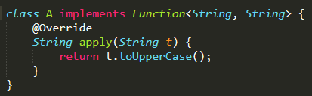
Function<T,R>
Type of Input
Type of Result
Abstract method: apply(T)

Slide 8
BiFunction<T,U,R>
Type of First Input
Type of Result
Type of Second Input
Abstract method: apply(T,U)
Important: Order of parameters matter (Character c, Integer i) -> (i + c); is different from (Integer i, Character c) -> (i + c);
BiFunction<Character, Integer, Integer>
BiFunction<Integer, Character, Integer>

Slide 9
Predicate<T>
Type of Input
Abstract method: test(T)
Equivalent to Function<T, Boolean>
A Predicate tests stuff.
“If statement in a variable”
Predicate<Integer> isEven = (i) -> (i % 2 == 0);

Slide 10
Supplier<T>
Type of Output
Abstract method: get()
A Supplier supplies.
Supplier<Integer> oneSupplier = () -> return 1;

Slide 11
Consumer<T>
Type of Input
Abstract method: accept(T v)
A Consumer consumes.
Consumer<String> printer = (s) -> System.out.println(s);

Slide 12
Common Functional Interfaces
Type | Input | Output
Function | ⭕️ | ⭕️
Predicate | ⭕️ | Boolean
Supplier | ❌ | ⭕️
Consumer | ⭕️ | ❌

Slide 13
Understanding Functional Programming
Stream<T>
Stream<T> filter(Predicate <? super T> predicate)
Stream<R> map(Function<? super T, ? extends R> mapper)
Stream<R> flatMap(Function<? super T, ? extends Stream<? extends R>> mapper)
Stream<T> limit(long maxSize)
And more https://docs.oracle.com/javase/10/docs/api/java/util/stream/Stream.html

Slide 14
Change of Mindset
STOP thinking of arrays or lists
STOP thinking of loops or if-else

Slide 15
A Farm Analogy
Stream<Seed>
You are now a farmer.
You are given some seeds, but you don’t know what they are.
Let’s first represent them as a Stream of Seeds:
Stream<Seed> seeds = …;

Slide 16
A Farm Analogy
Stream<Seed>
map
Stream<Plant>
What do you do when a stranger gives you seeds? You plant them.
Convert Stream of Seeds into Stream of Plants
Stream<Plants> plants = seeds.map(plantFunction);

Slide 17
A Farm Analogy
Stream<Seed>
map
♻️
Stream<Plant>
Some of the plants were weeds.
Kill them.
Filter away weeds from useful plants
Stream<FruitPlant> fruitingPlants = plants.filter(isNotWeed);
Weed
filter
Stream<FruitPlant>
(Technically Stream<Plant> still as filter does not change the type)

Slide 18
A Farm Analogy
Stream<Seed>
map
♻️
Stream<Plant>
Harvest the fruits. How to do it?
Have: Stream<FruitPlant> fruitingPlants
Want: Stream<Fruit> fruits
Stream<Fruit> fruits = fruitingPlants.map(pluckFruitsFunction);
WRONG.
Weed
filter
Stream<FruitPlant>
map
Stream<Fruit>

Slide 19
A Farm Analogy
Stream<Seed>
map
Function<FruitPlant, Stream<Fruit>>
♻️
Stream<Plant>
fruitingPlants.map(pluckFruitsFunction);
Plants produce multiple fruits! i.e. Stream<Fruit> for each plant
Will produce Stream<Stream<Fruit>>
How to solve?
Combine all the streams into one stream with another map?
fruitingPlants.map(pluckFruitsFunction) .map((Stream<Fruit> s) -> ???);
Use a loop to combine?
NO LOOPS!!! (Because then you can’t chain actions)
Weed
filter
Stream<FruitPlant>
map
Stream<Stream<Fruit>>

Slide 20
A Farm Analogy
Stream<Seed>
map
Function<FruitPlant, Stream<Fruit>>
♻️
Stream<Plant>
fruitingPlants.map(pluckFruitsFunction);
Plants produce multiple fruits! i.e. Stream<Fruit> for each plant
Will produce Stream<Stream<Fruit>>
How to solve?
Use flatMap! FlatMap combines multiple output streams into one i.e. mapping function must be Function<T, Stream<R>>
Stream<Fruit> fruits = fruitingPlants.flatMap(pluckFruitsFunction);
Weed
filter
Stream<FruitPlant>
flatMap
Stream<Fruit>

Slide 21
A Farm Analogy
Stream<Seed>
map
♻️
Stream<Plant>
Now we can do many things
fruits.limit(5).forEach(eat);
Stream<Money> money = fruits.map(sellFruitFn);
Fruit[] uniqueFruits = fruits.distinct().toArray();
Java Streams CANNOT be reused
A stream should be operated on (invoking an intermediate or terminal stream operation) only once. This rules out, for example, "forked" streams, where the same source feeds two or more pipelines, or multiple traversals of the same stream. (https://docs.oracle.com/javase/8/docs/api/java/util/stream/Stream.html)
Weed
filter
Stream<FruitPlant>
flatMap
Stream<Fruit>

Slide 22
A Farm Analogy
Stream<Seed>
map
♻️
Stream<Plant>
Chain methods together
Stream<Fruit> fruits = seeds.map(plantFunction) .filter(IsNotWeed) .flatMap(pluckFruitsFunction)
Weed
filter
Stream<FruitPlant>
flatMap
Stream<Fruit>

Slide 23
Change of Mindset
STOP thinking of arrays or lists
STOP thinking of loops or if-else
Think in terms of data
FP is applying transformations to a set of data to get an end result
Connecting different pipes together to turn a circle into a square

Slide 24
Why FP?
Function chaining makes code more readable
Sometimes it makes more sense to think in terms of pipes & transformations

Slide 25
Tutorial 6
By Jeremy Lim

Slide 26
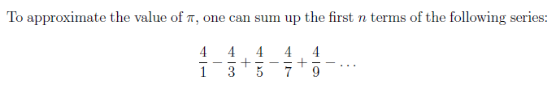
Q1: Pi Approx. using IntStream
- + - + - …
+2
+2
+2
+2
Iterative: for (i = 1; i < 2n+1; i += 2) {…}

Slide 27
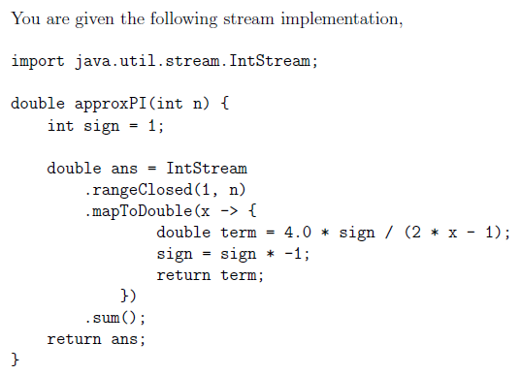
Q1: Pi Approx. using IntStream
What are the errors?

Slide 28
Q1: Pi Approx. using IntStream
Should be self-contained
Side effect

Slide 29
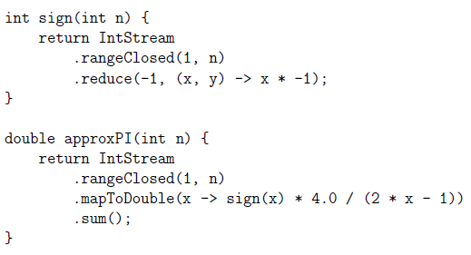
Q1: Pi Approx. using IntStream
Suggested Answer
Reduce(a, f(x,y)): a is the starting point, f is a BiFunction
Repeatedly set a = f(a,y) for all y in the stream, e.g.
Stream is [1,2,3,4,5…], a = 0, f(x,y) = x + y
1. a = f(0, 1) = 1
2. a = f(1, 2) = 3
3. a = f(3, 3) = 6
…
return (final a)

Slide 30
Q1: Pi Approx. using IntStream
Suggested Answer
Alternates between 1 and -1

Slide 31
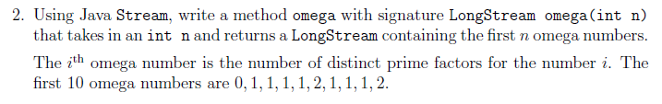
Q2: Omega numbers

Slide 32
Q2: Omega numbers
Approach:
Find number of distinct prime factors for a number i
-> Find prime factors for a number i (then count)
-> Find factors for a number i (then filter out non-prime)
-> Check if a number is prime

Slide 33
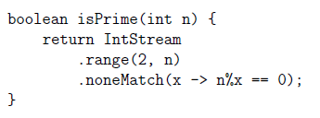
Q2: Omega numbers
Approach:
Find number of distinct prime factors for a number i
-> Find prime factors for a number i (then count)
-> Find factors for a number i (then filter out non-prime)
-> Check if a number is prime [isPrime(n)]
“n is in stream if nothing divides n”

Slide 34
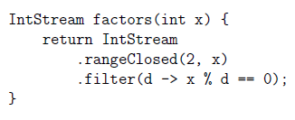
Q2: Omega numbers
Approach:
Find number of distinct prime factors for a number i
-> Find prime factors for a number i (then count)
-> Find factors for a number i (then filter out non-prime) [factors(x)]
-> Check if a number is prime [isPrime(n)]
“d is in stream if d divides x”

Slide 35

Q2: Omega numbers
Approach:
Find number of distinct prime factors for a number i
-> Find prime factors for a number i (then count) [primeFactors(x)]
-> Find factors for a number i (then filter out non-prime) [factors(x)]
-> Check if a number is prime [isPrime(n)]

Slide 36
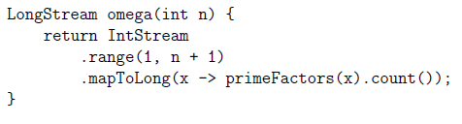
Q2: Omega numbers
Approach:
Find number of distinct prime factors for a number i
-> Find prime factors for a number i (then count) [primeFactors(x)]
-> Find factors for a number i (then filter out non-prime) [factors(x)]
-> Check if a number is prime [isPrime(n)]

Slide 37
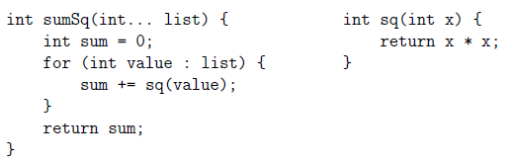
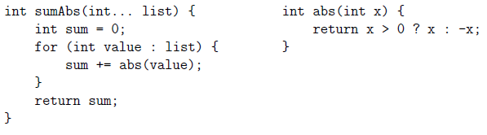
Q3: IntUnaryOperator (i.e. read the Javadocs)
Sum of squares
Sum of absolutes

Slide 38
Q3: IntUnaryOperator (i.e. read the Javadocs)
Sum of squares
Note very little difference. Can we abstract this?
Sum of absolutes

Slide 39
Q3: IntUnaryOperator (i.e. read the Javadocs)
Sum of squares
Equivalent to a function that takes int and returns int int f(int x)
Use a Functional Interface!
Sum of absolutes

Slide 40
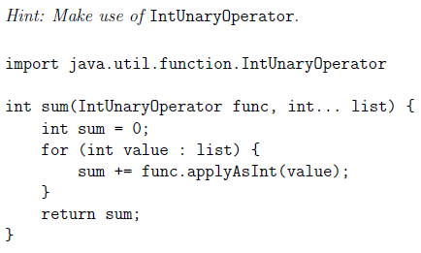
Q3: IntUnaryOperator (i.e. read the Javadocs)
Functional Interface of int applyAsInt(int x)
Pass in the appropriate func

Slide 41


Q3: IntUnaryOperator (i.e. read the Javadocs)
Sum of squares
Sum of absolutes

Slide 42
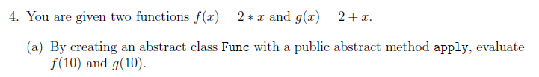
Q4a: Anonymous classes

Slide 43

Q4a: Anonymous classes

Slide 44
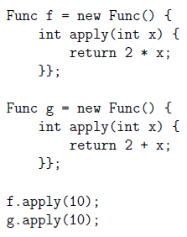
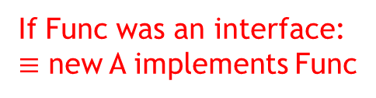

Q4a: Anonymous classes
$≡$ new A extends Func
If Func was an interface:
$≡$ new A implements Func

Slide 45
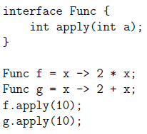
Q4a: Anonymous classes
Extra: Func as a functional interface
Abstract class cannot be used as a functional interface

Slide 46

Q4b: Composition of functions

Slide 47
Q4b: Composition of functions
This is a Func
Need method signature: Func compose(Func g)

Slide 48
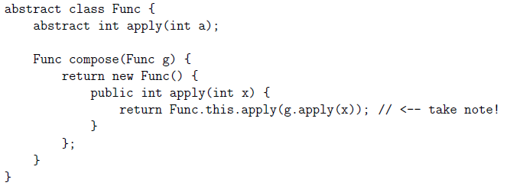
Q4b: Composition of functions
This is a Func
Need method signature: Func compose(Func g)
Apply g first
Then apply f

Slide 49
Q4b: Composition of functions
This is a Func
Need method signature: Func compose(Func g)
Func.this
Apply g first
this
Then apply f
Refer to “this” in containing class context

Slide 50
Q5b and c: Currying (Q5a Skipped)
We have Function (1 argument), BiFunction (2 arguments)
What if we need 3 or more arguments?
Currying: Set 1 argument at a time
E.g. x -> y -> x + y

Slide 51
Q5b and c: Currying (Q5a Skipped)
We have Function (1 argument), BiFunction (2 arguments)
What if we need 3 or more arguments?
Currying: Set 1 argument at a time
E.g. x -> y -> x + y
Output: Function<Integer, Integer> or IntUnaryOperator
Input: Integer
Type of lambda: Function<Integer, Function<Integer, Integer>> or IntFunction<IntUnaryOperator>
IntFunction<T> -> Function<Integer, T>

Slide 52
Example
Function<Integer, Function<Integer, Integer>> f = x -> y -> x + y;
Function<Integer, Integer> g = f.apply(1);
f(1): 1 -> y -> 1 + y
Output Function: g = y -> 1 + y
G.apply(2) [Returns 3]

Slide 53
Q5b and c

Slide 54

Like my tutorials? Want to raise my grades? Don’t like my tutorials? Want to decrease my grades?
Sign up for STEPS and vote for my project on 17th April! (Or help someone else win)
http://isteps.comp.nus.edu.sg/event/14th-steps
Top few get higher project marks!
(CS3243 Group 1)

Slide 55
Like my tutorials? Want to raise my grades? Don’t like my tutorials? Want to decrease my grades?
Sign up for STEPS and vote for my project on 17th April! (Or help someone else win)
http://isteps.comp.nus.edu.sg/event/14th-steps
Top few get higher project marks!
(CS3243 Group 1)
If you laughed at the picture you owe me a vote

